Slide 1
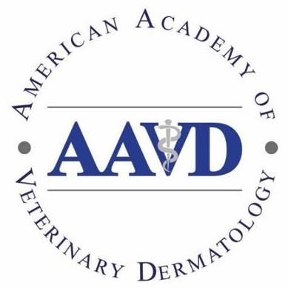
Why should you become an AAVD member ?
Receive Derm Dialogue 2x yr ( summaries of roundtables)
Access archived past derm dialogue on www.AAVD.org
Receive reduced registration to NAVDF and WCVD meetings
Receive reduced rate for purchasing subscription to Vet Derm
Support AAVD Student Award in veterinary dermatology program
Support Research grant AAVD/ACVD $15,000 to promote new discoveries in veterinary dermatology
Support one free NAVDF congress registration for AAVD Technician (lottery award)
On line round tables, grant awards to attend the WCVD9

Slide 2
The AAVD is the oldest veterinary dermatology professional organization in the world and it is dedicated to promoting the field of veterinary dermatology, in education, research, and professional veterinary practice.
AAVD members are worldwide and include veterinary dermatologists, internists, pathologists, general practice veterinarians, veterinarians in industry, residents in specialty training programs, veterinary technicians, and veterinary students.

Slide 3
Consider joining the Academy
Receive Derm Dialogue 2x yr ( summaries of roundtables)
Access archived past derm dialogue on www.AAVD.org
Receive reduced registration to NAVDF and WCVD meetings
Receive reduced rate for purchasing subscription to Vet Derm
Support AAVD Student Awards in veterinary dermatology
Support Research grant AAVD/ACVD $15,000 to promote new discoveries in veterinary dermatology
Support one free NAVDF congress registration for AAVD Technician
On line round tables
https://www.aavd.org/membership.html

Slide 4
https://www.aavd.org/membership.html
Receive Derm Dialogue 2x yr ( summaries of roundtables)
Access archived past derm dialogue on www.AAVD.org
Receive reduced registration to NAVDF and WCVD meetings
Receive reduced rate for purchasing subscription to Vet Derm
Support AAVD Student Awards in veterinary dermatology
Support Research grant AAVD/ACVD $15,000 to promote new discoveries in veterinary dermatology
Support one free NAVDF congress registration for AAVD Technician
On line round tables
The AAVD is the oldest veterinary dermatology professional organization in the world
and it is dedicated to promoting the field of veterinary dermatology, in education, research, and professional veterinary practice

